Slide 1


Stablecoins and MakerDao
Notes:
Intro
Kenton Prescott
5th Year Aerospace Engineering
With a deep interest in software
Here to talk on Stablecoins and Makerdao

Slide 2
Agenda
Problems with instability
Makerdao
Dai Dynamics
Other Stablecoin types
Dai metrics
Roadmap

Slide 3
Is this the graph of a *currency* ?
Notes:
Describe graph

Slide 4
State of the Blockchain community
Moral Arguments
Objective Arguments
Decentralization
Trustless
Accessibility
Censorship resistant
No single point of failure
Redundancy
Faster settlement
Efficient financial markets
Cost savings
Absence of trust paths
Better Price Discovery
Absence of “cover” fees
Notes:
Bit fast because the good stuff is at the end
This is my attempt to remind everyone of the value of objectivism
Two umbrellas
Moral arguments
Trade efficiency
Left umbrella -> more concentrated in the right side
The right side is what drives profit-seeking businesses to adopt new tech
Keep this in mind as well go through the presentation

Slide 5
Notes:
Makerdao
Started before the ethereum project was launched and set out to create the best stable coin
May be worth mentioning:
A stable coin needs key features
Decentralized
Fundamental stability that has been proven -> real assets and real value that backs the stable coin

Slide 6

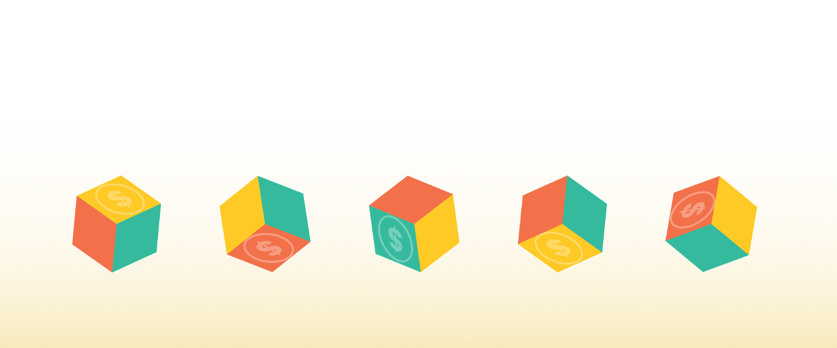
Meet Maker
Unlocking the power of the Blockchain to create economic empowerment.
Notes:
Maker’s Mission is to unlock the power of the blockchain to create economic empowerment

Slide 7
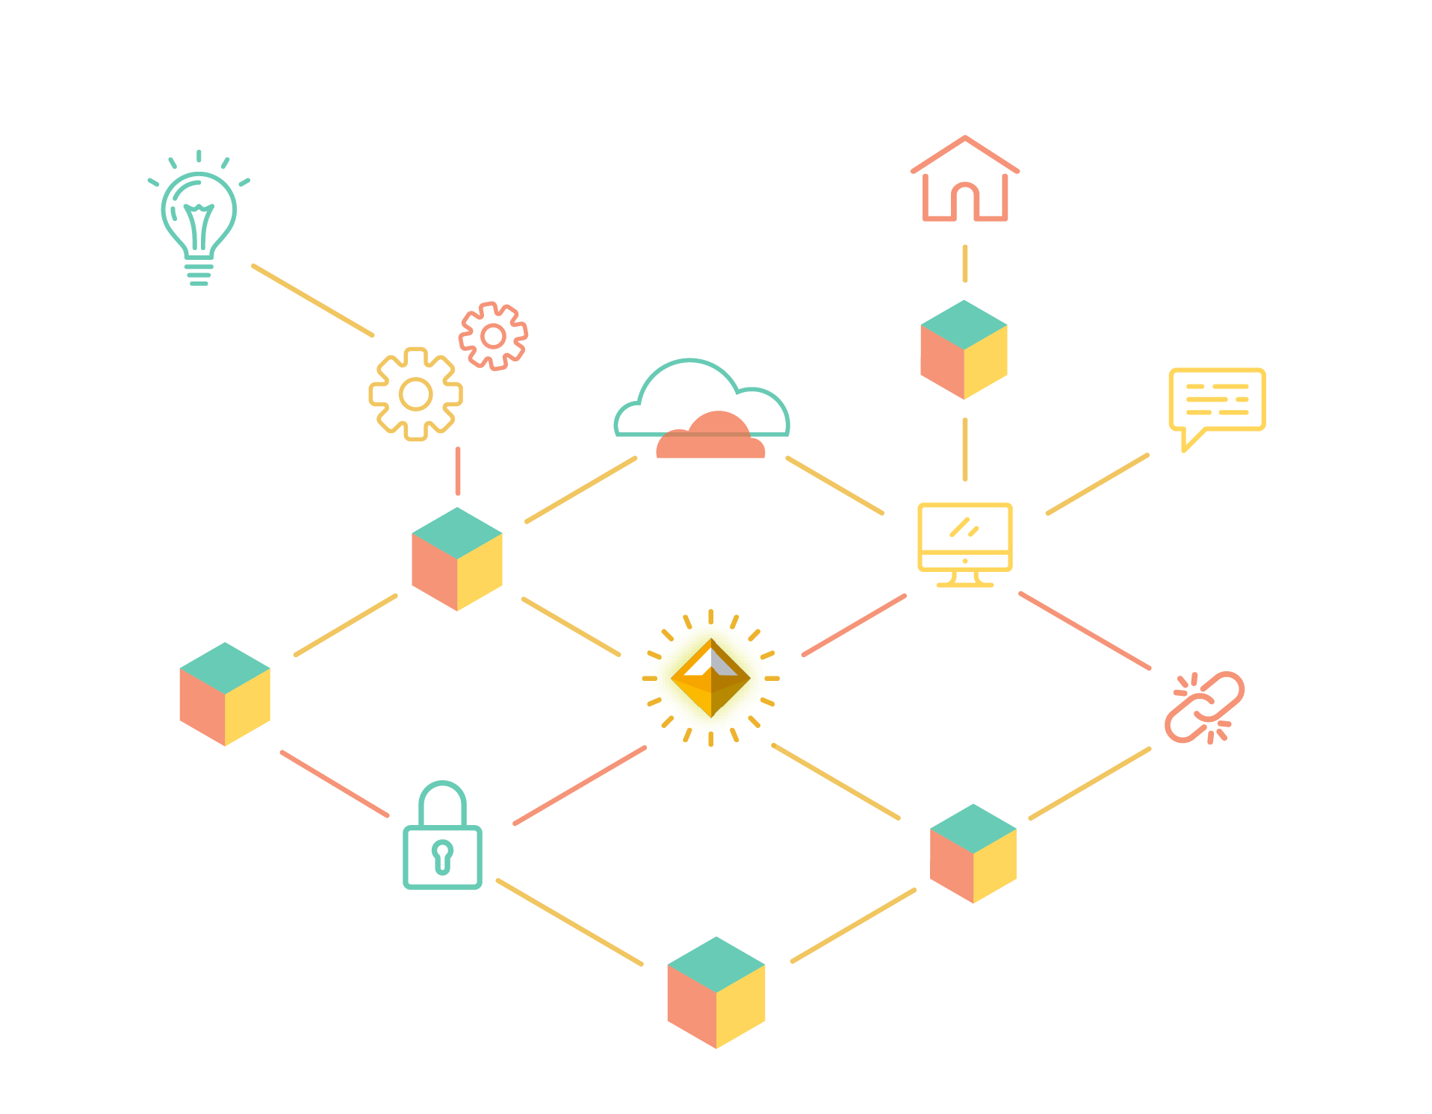
A stablecoin is needed for mainstream adoption of cryptocurrencies.
Notes:
The next phase of the financial revolution will be unlocked when a decentralized, safe, secure stablecoin has achieved scale in the marketplace.

Slide 8
Maker’s Stablecoin
DAI - Flagship Product
Asset backed hard currency
Soft-pegged to the USD
Permissionless credit factory
in Ethereum Smart Contracts
Notes:
An attempt to create a stablecoin that has everything necessary to unlock the potential of blockchain.
Crypto asset ment for the end user
Crypto collateralized stablecoin
Stability is backed by a decentralized platform, and on this decentralized platform there are different types of collateral (ethereum, tokenized asset, such as digix gold), they are combined into a portfolio of assets that together back the stability of dai.

Slide 9
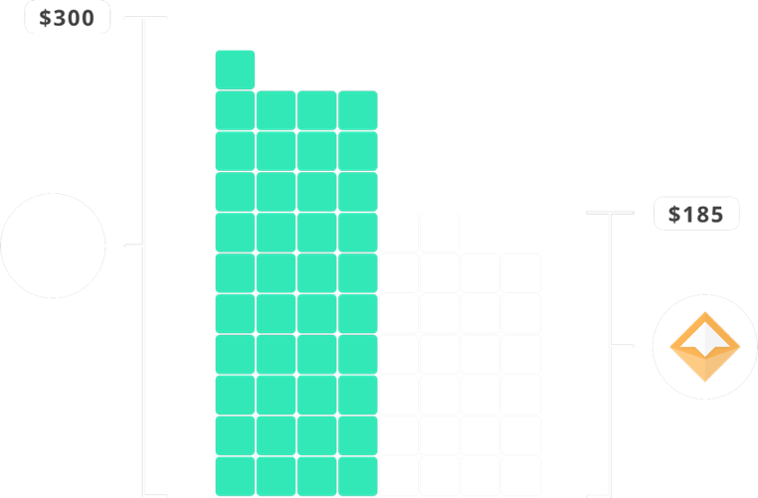
Dai - Mechanics
Collateralized Debt Position (CDP)
Borrow Dai through locking up collateral
Repay Dai + fee to retrieve collateral
Safe, over-collateralized CDP
Notes:
The second and third reasons one would interact with the Dai Credit System is via what we call a Collateralized Debt Position, or CDP for short. Both of these use cases are speculative and are dependent on the creator having faith in the future value increase of the asset they are depositing into the CDP.
Overcollateralization ensures that in event of a rapid decrease in asset price that a CDP can be liquidated with extra value to spare. This ensures that Dai holders can sleep well at night knowing that no matter what happens to the price of the asset backing their Dai that they can always receive equivalent value of the assets backing the Dai in circulation.
At the time of writing CDP’s were currently 370% over-collateralized.

Slide 10
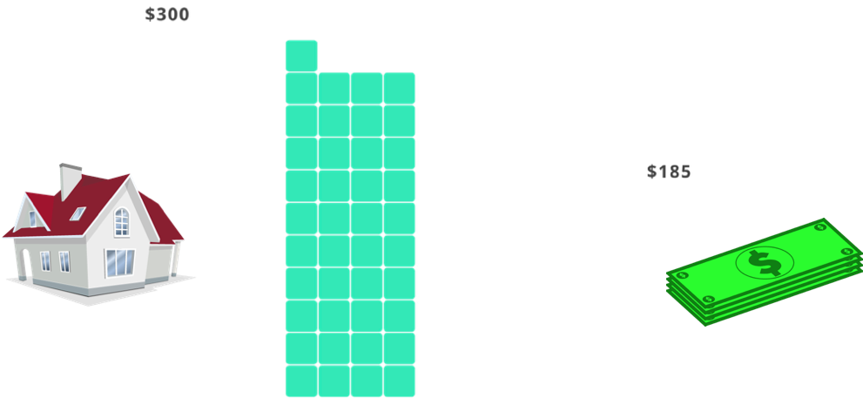
Dai - Mechanics
Analogous to a Mortgage
Repay debt + interest to “retrieve” the house
Borrow money with a mortgage from the bank

Slide 11
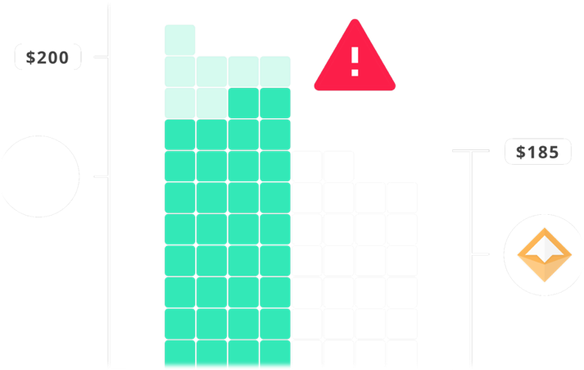
Dai - Mechanics
Liquidations
CDP is automatically margin called if the collateral falls too low
Collateral is sold off, by the smart contract, to anyone who will buy it
CDP owner receives the leftover collateral

Slide 12
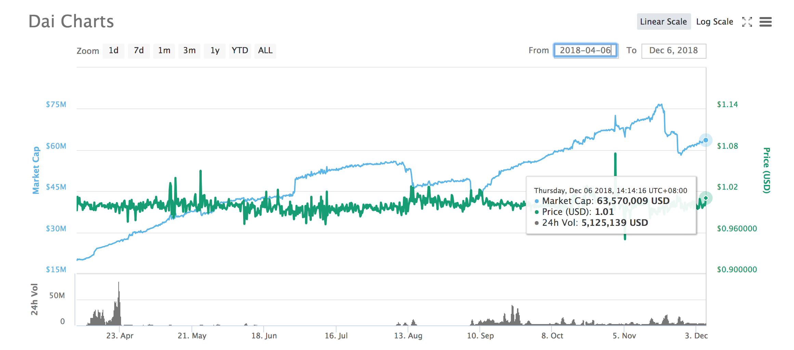
CDPs opened
4847
Dai drawn
61,336,717 current
154,097,456 total
Dai Metrics
Notes:
Explain each colored chart

Slide 13
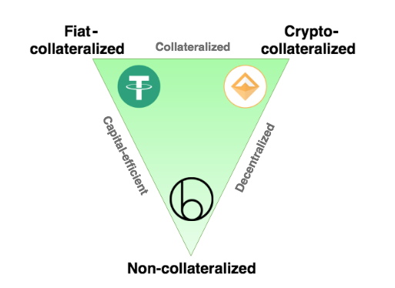
Not all stablecoins are equal
I give you 1 stablecoin (or “IOU”) for 1 dollar
Lock crypto asset into a smart contract and draw stable coin
Algorithms control token supply
https://hackernoon.com/stablecoins-designing-a-price-stable-cryptocurrency-6bf24e2689e5
Notes:
Let’s take a quick look at the various forms of stable coin systems that are either planned or are in existence today:
Centralized:
IOU Model: (a token which is based on the principle of “when you give me fiat, then i give you a token which signifies that I owe you the redeemable value of that token”) Holders of the token need to trust a traditional, centralized organization or a legal agreement.
Decentralized & enabled by smart contracts:
Seigniorage shares model: Trust that the future value of the underlying bonds always increases, the economics incentives and structure are sound and that the smart contracts are secure.
Over-collateralized, Globally settleable Model: Trust the security of the smart contracts and the economic incentivizes and structure which ensure it’s stability.

Slide 14
Maker’s Governance Token
MKR
Governance Token
MKR holders make decisions about how the Dai system runs
Also used to pay back the fees on a CDP
Notes:
Governance token that controls the platform that backs the dai stable coin
For the advanced user that wants to get into the advanced governance of a decentralized financial platform
Maker holders make the crucial decisions on what collaterals to allow into the system and on what terms.
E.g. ethereum should be more risky than tokenized gold, which is more risky than tokenized bonds
MKR is used for voting in new collateral types and it is also used to vote on the risk parameters associated with these collateral types.
It is also a necessary ingredient to close a CDP and is thus the fuel for the Dai Credit System

Slide 15

Functions
Supply chain
Lending
Remittances
Exchange pairs
Payments/online purchases
Decentralized Margin
Hedging against volatility
Prediction Markets
Notes:
Any financial service or product can be imagined with the use of Dai

Slide 16
Properties of a durable stablecoin
Over collateralized:
Always the equivalent of more money backing Dai than the Dai in circulation.
Multi-collateral:
Resilience in the face of black swans.
Notes:
To summarize, these are the methods that ensure the security and stability of multi collateral Dai:
Diversifed, uncorrelated collateral pool which is thus reslient in the face of black swans
Over collateralization and the threat of global settlement at any time ensure the stability of Dai.
Arbitrageurs provide liquidity at the peg because they know that the system can be shut down at any time and have exactly $1 worth of collateral returned to them.
The old instance of Dai is then rendered invalid and the holder is prompted to migrate to the new instance by redeeming the old instance

Slide 17
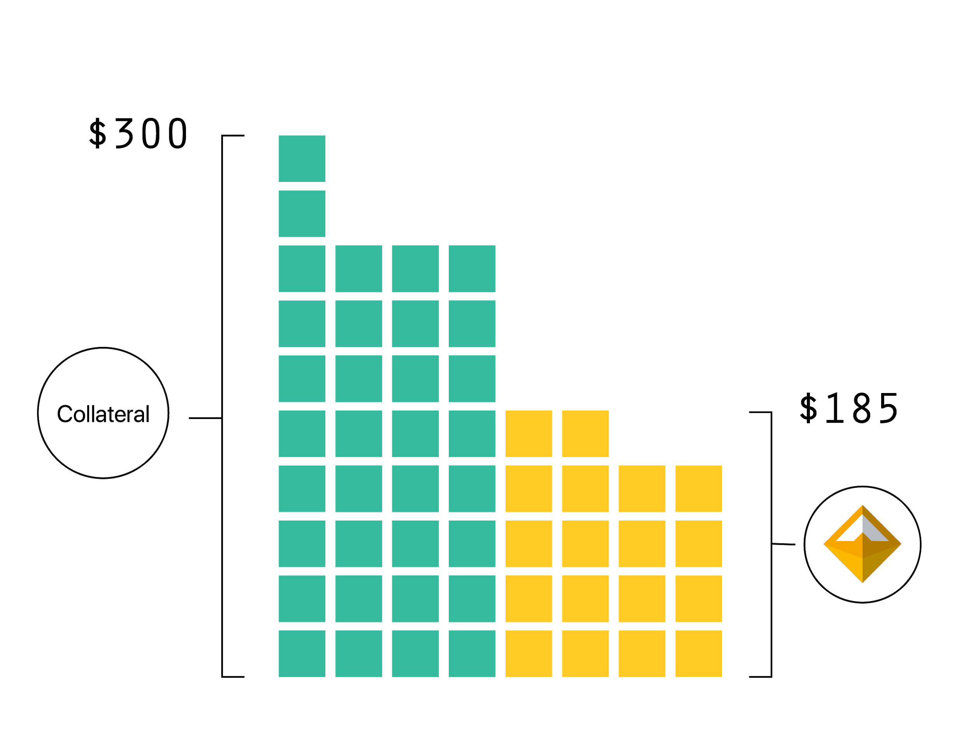
Properties of a durable stablecoin
Over collateralized:
Always a higher value of collateralized assets backing Dai than the Dai in circulation.
Notes:
Overcollateralization ensures that in event of a rapid decrease in asset price that a CDP can be liquidated with extra value to spare. This ensures that Dai holders can sleep well at night knowing that no matter what happens to the price of the asset backing their Dai that they can always receive equivalent value of the assets backing the Dai in circulation.
At the time of writing CDP’s were currently 370% over-collateralized.

Slide 18
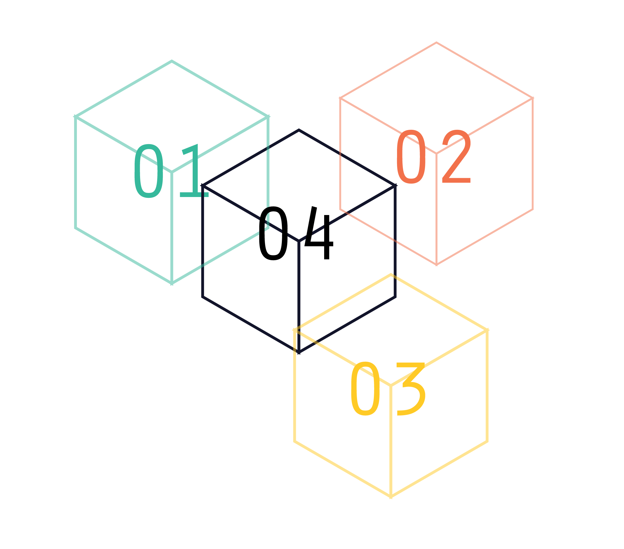
Properties of a durable stablecoin
Multi-collateral:
Resilience in the face of black swans.
Notes:
The current version of Dai in the wild is single collateral which means that if a black swan were to occur and the price of ETH was to drop instantaneously across all exchanges at once to 0, then Dai would fail. The multi collateral version of Dai is due to be released in June will be resilient even in the face of such an event because the collateral pool will be diversified with non-correlated assets. This means that even if one collateral type fails completely that Dai holders would still be made whole because all CDPs in which the Dai were created are all over-collateralized.

Slide 19
Timeline
Single Collateral:
Ethereum
Multi Collateral:
Ethereum
Bonds
Real estate
Tokenized invoices
Multi-Collateral Dai (MCD)
Sai (Alpha)
Dai (Beta)
December 2016
December 2017
Early 2019

Slide 20
Timeline
Multi-Collateral Dai
Synthetic Dai
(euroDai, yenDai, etc)
Late 2019
Early 2019
MCD Improvements:
Collateral Types
Price Feed Oracles
MKR Governance
Liquidation Auctions
and much more!

Slide 21
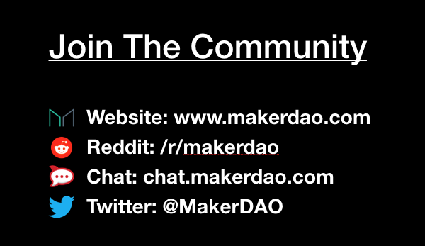
Find out more and get involved!

